Slide 1

File Handling in Java: Best Practices and Essential Techniques
By : Janak Raj Joshi

Slide 2

Mastering File Handling in Java
File handling is an essential part of any Java application. It enables you to read, write, and manipulate ﬁles and directories. In this presentation, we will cover the best practices and essential techniques for mastering ﬁle handling in Java.

Slide 3

Understanding File I/O in Java
File I/O in Java involves reading and writing data to and from ﬁles. We will cover the InputStream and OutputStream classes, which are used for reading and writing binary data, as well as the Reader and Writer classes, which are used for reading and writing character data.

Slide 4

Working with Files and Directories
Java provides several classes and methods for working with ﬁles and directories, including the File class, which represents a ﬁle or directory path, and the Path class, which provides a more ﬂexible way of working with ﬁle paths. We will also cover the java.nio.ﬁle package, which provides additional ﬁle system operations.

Slide 5

Handling Exceptions in File I/O
File I/O operations can throw
exceptions, such as
FileNotFoundException and
IOException. We will cover how to handle these exceptions using try- catch blocks and the throws keyword. We will also discuss the importance of closing streams and resources properly.

Slide 6

Reading and Writing Text Files
Text ﬁles are a common type of ﬁle that can be easily read and written in Java.
We will cover how to use the
BufferedReader and BufferedWriter classes for efﬁcient reading and writing of text ﬁles. We will also discuss how to handle different character encodings.

Slide 7
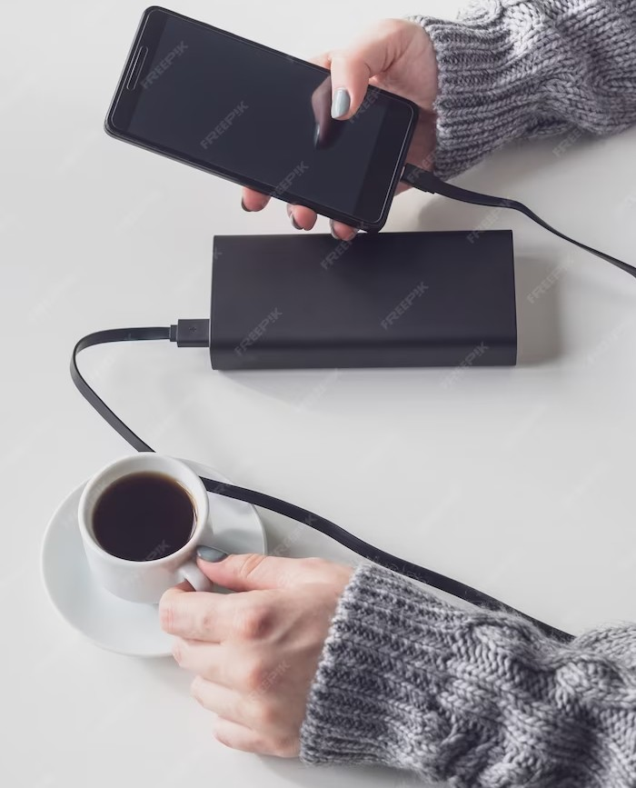
Using Java Serialization
Java Serialization is a mechanism for converting objects into a stream of bytes that can be saved to a ﬁle or transmitted over a network. We will cover how to use the ObjectInputStream and ObjectOutputStream classes for serialization and deserialization of objects.

Slide 8

Working with Compressed Files
Compressed ﬁles, such as ZIP and GZIP ﬁles, are a common way of storing and transmitting large amounts of data. We will cover how to use the ZipInputStream, ZipOutputStream, GZIPInputStream, and GZIPOutputStream classes for working with compressed ﬁles in Java.

Slide 9
Conclusion
File handling is a fundamental part of Java programming. By mastering the best practices and essential techniques covered in this presentation, you will be able to work with ﬁles and directories in a professional and efﬁcient manner. Thank you for your attention!

Slide 10
Thanks!

